Slide 1
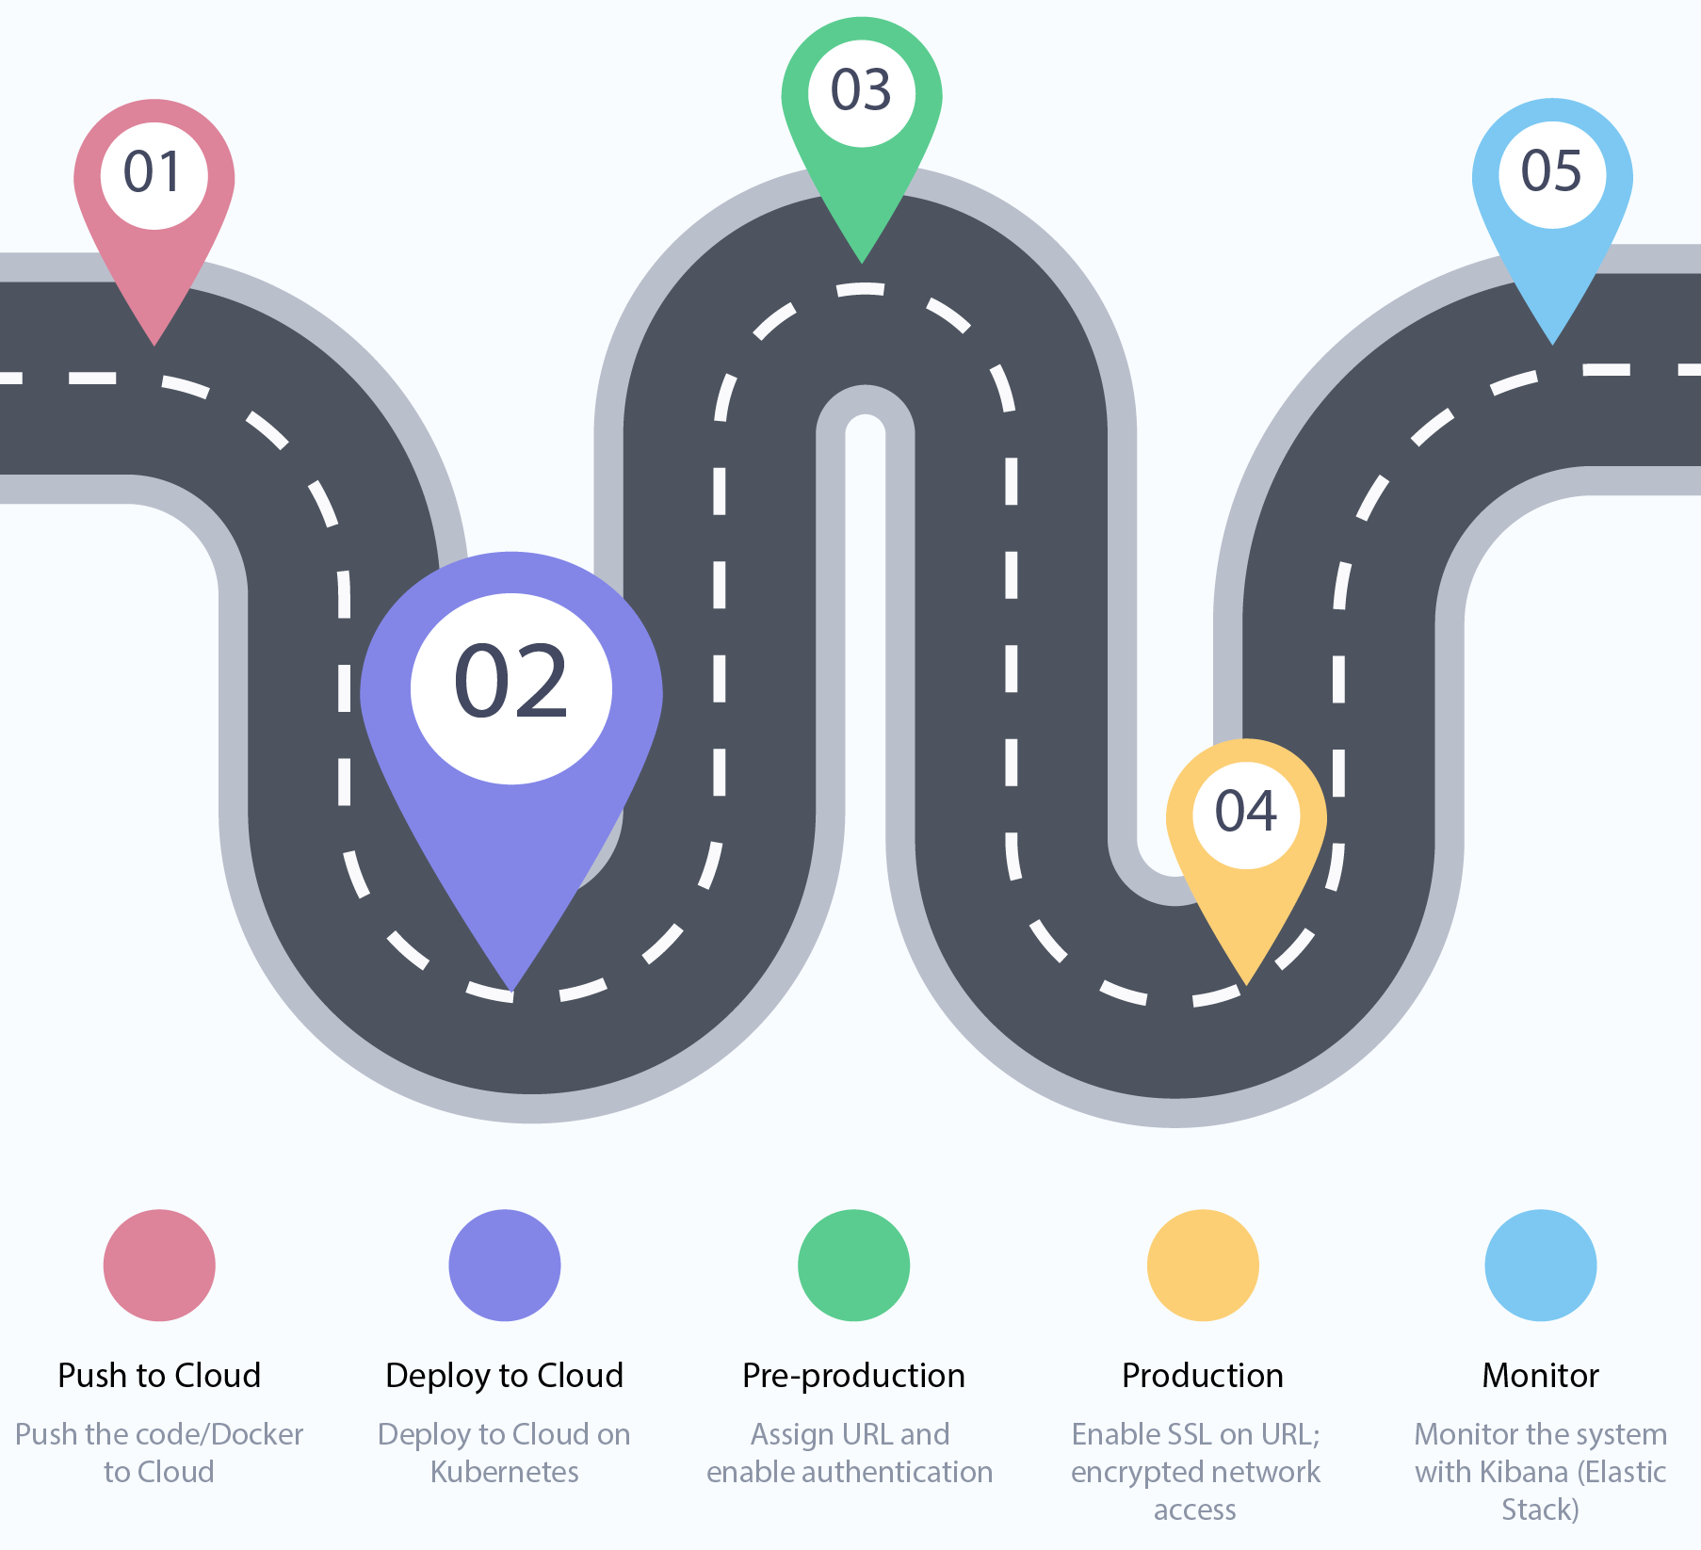

Slide 2
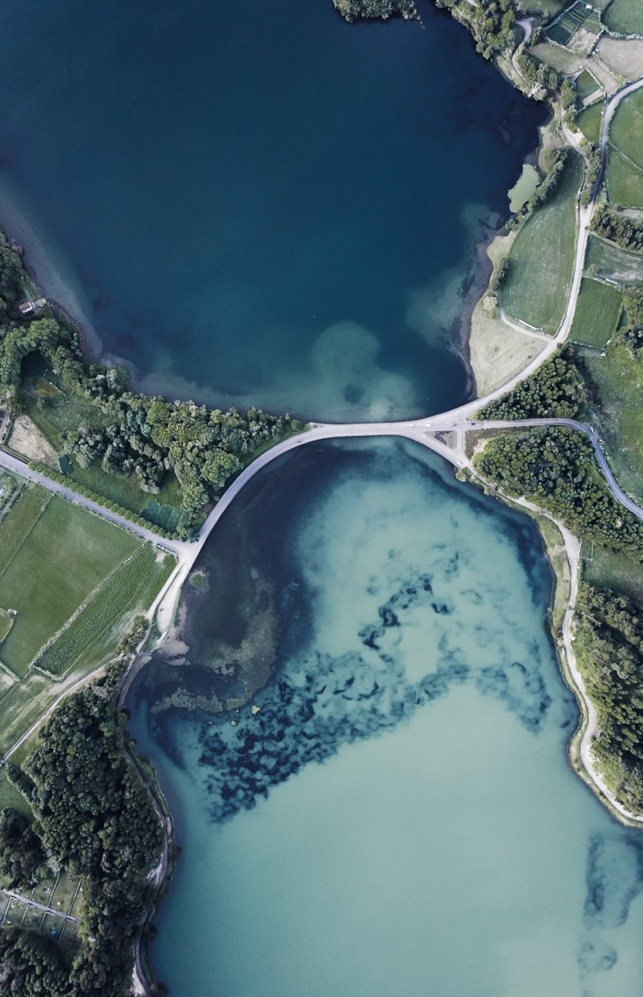
Intro to Kubernetes
A course in history

Slide 3
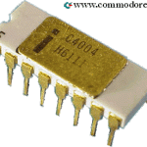
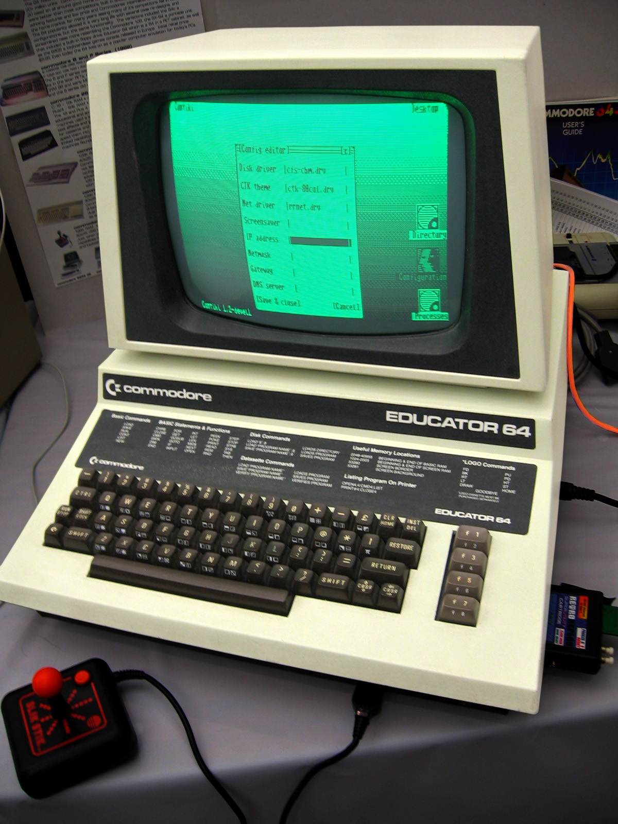
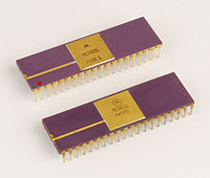
All started from local machine
All code starts from developers machine, so it makes sense to run it in the same place with the same HARDWARE.
Hardware was the PLATFORM to run software.
Image: Thomas Watson with ibm 701

Slide 4
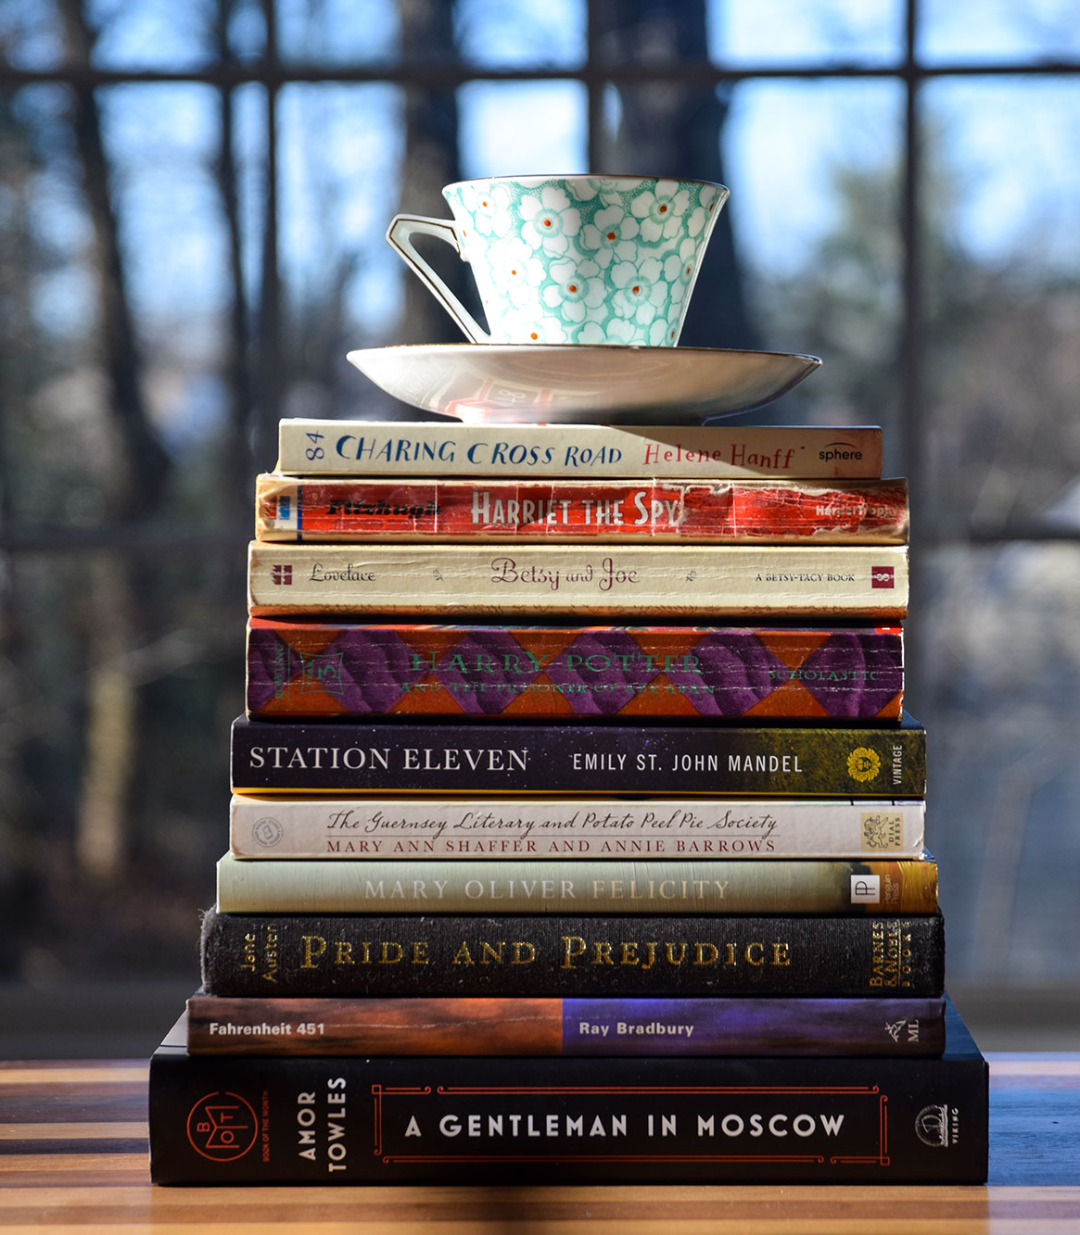
Technology stack
App
Hardware
Your company name

Slide 5
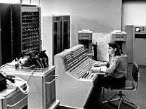
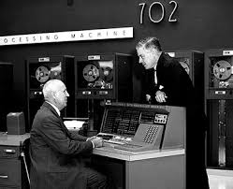
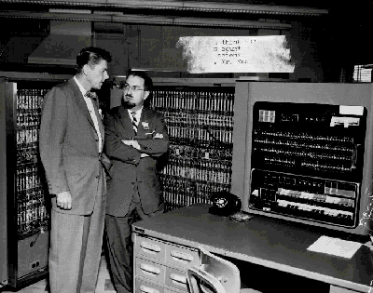
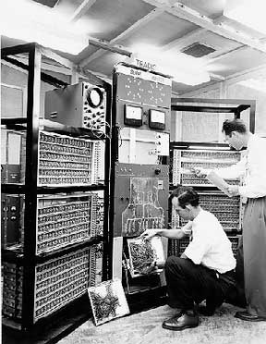
More computers? Different hardware?
Operating systems like Windows Server, Linux, … helped in having a good base for running software.
We can say operating systems became the new PLATFORM.

Slide 6
Technology stack
App
Hardware
OS
Your company name

Slide 7
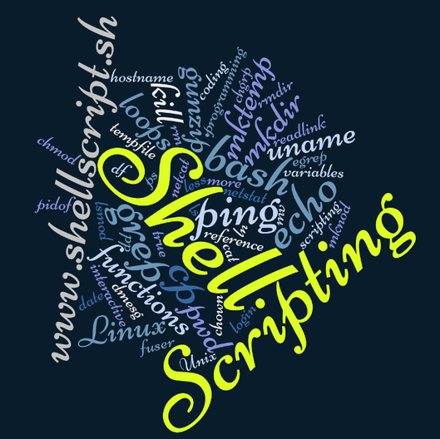
Lets have unified setup with …
Install the required software + configuration.
Your company name

Slide 8
Technology stack
App
Hardware
OS
Libs
Your company name

Slide 9
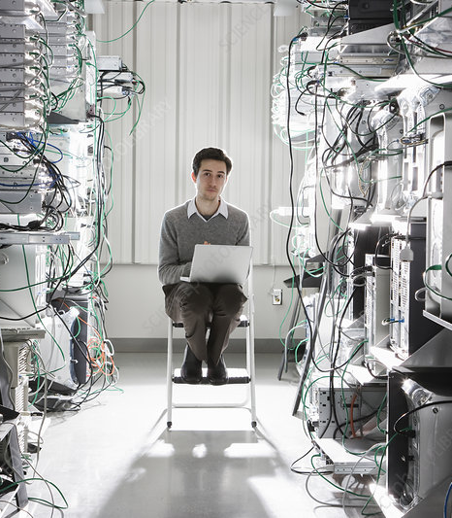

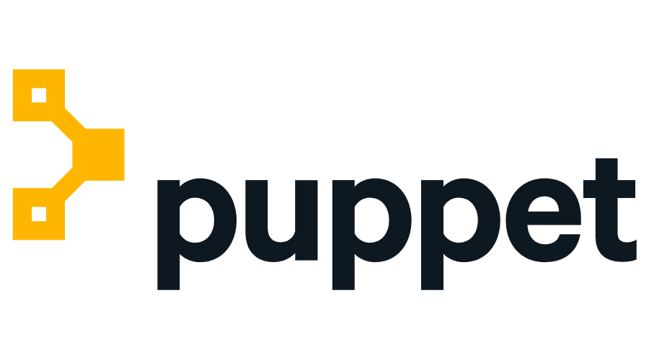
What if more servers?
Stream-lined scripting with different solutions.
Your company name

Slide 10
Technology stack
App
Hardware
OS
Libs
Your company name

Slide 11
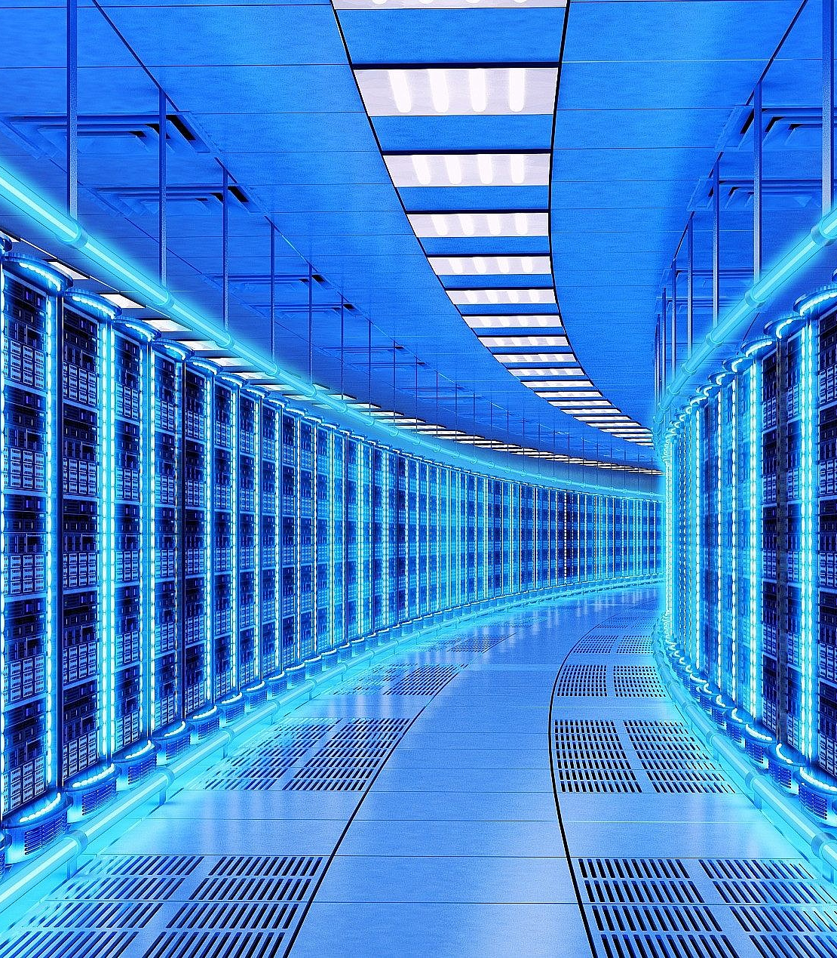
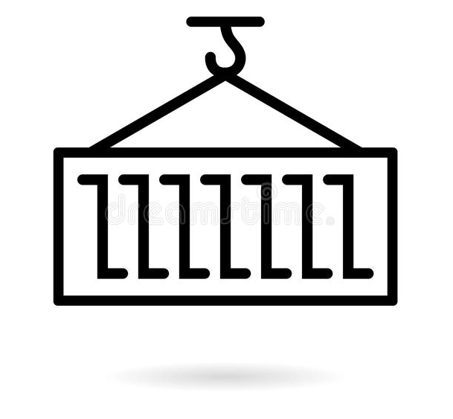
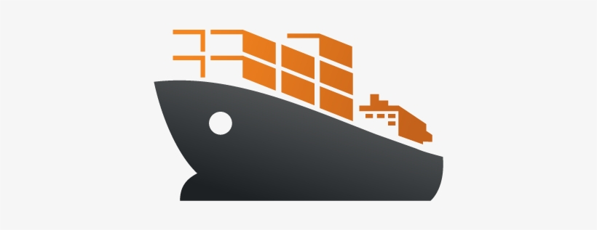
Still headache managing many varieties of operating systems
Your company name

Slide 12
Technology stack
App
Hardware
OS
Libs
Your company name

Slide 13
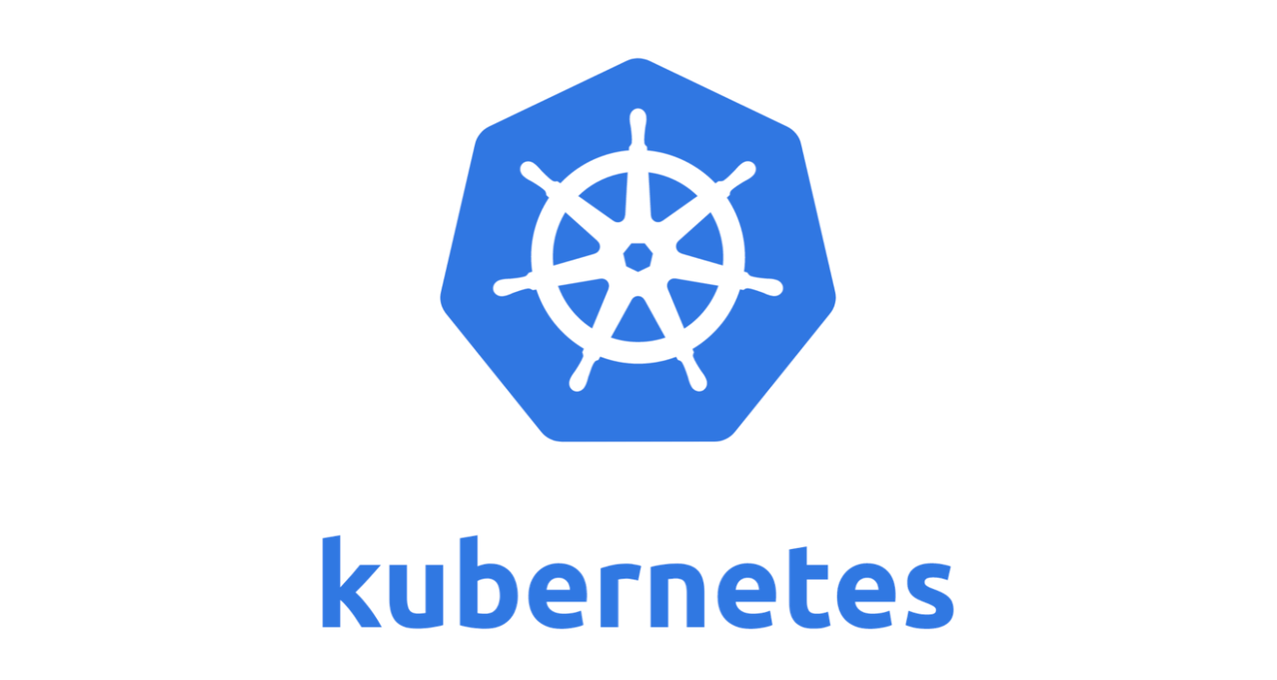
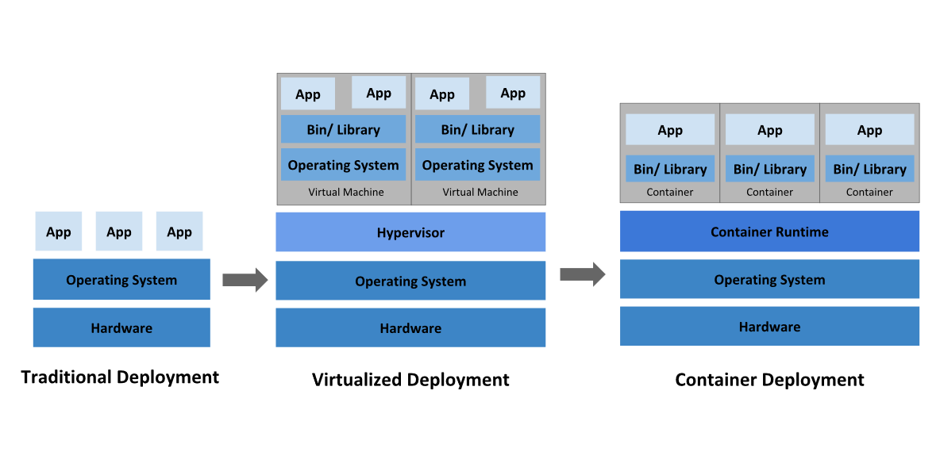
This technology made cloud possible

Slide 14
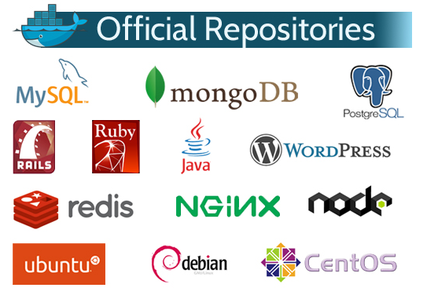

Slide 15
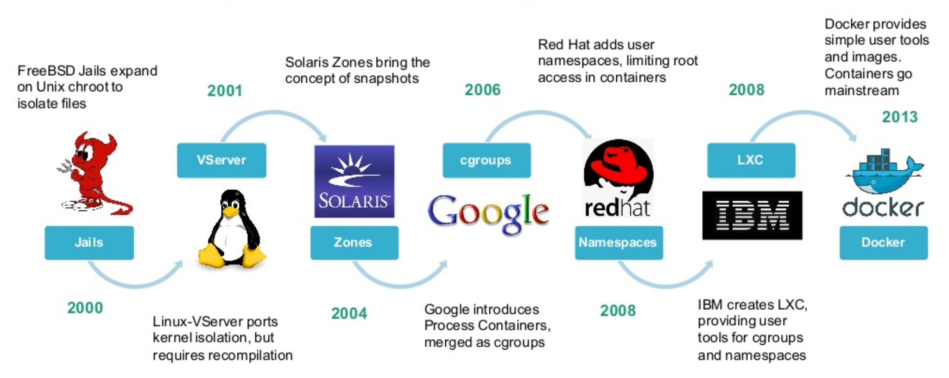

Slide 16



We need a central place to store the containers
Private space
Near to the place we use containers
Secure network connection to us + server farms
Your company name

Slide 17
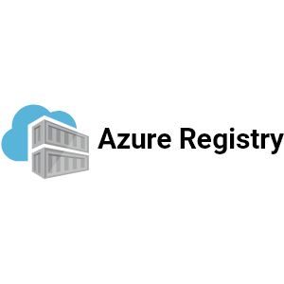
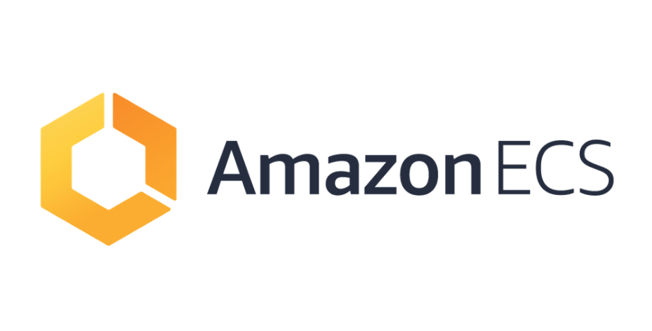
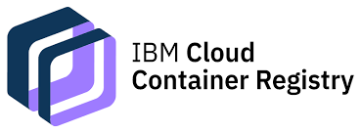
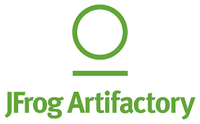
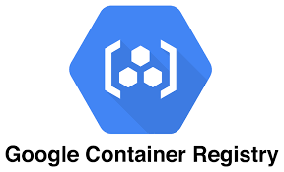
Container registries
Every cloud provider has its own container registries …
Your company name

Slide 18

Workshop
Your company name

Slide 19

Thank You
#training-code2cloud
Confluence > Site Reliability Engineering Space

